Slide 1
United Way of Central Indiana
Ceceily Brickley, Director Great Families 2020

Slide 2
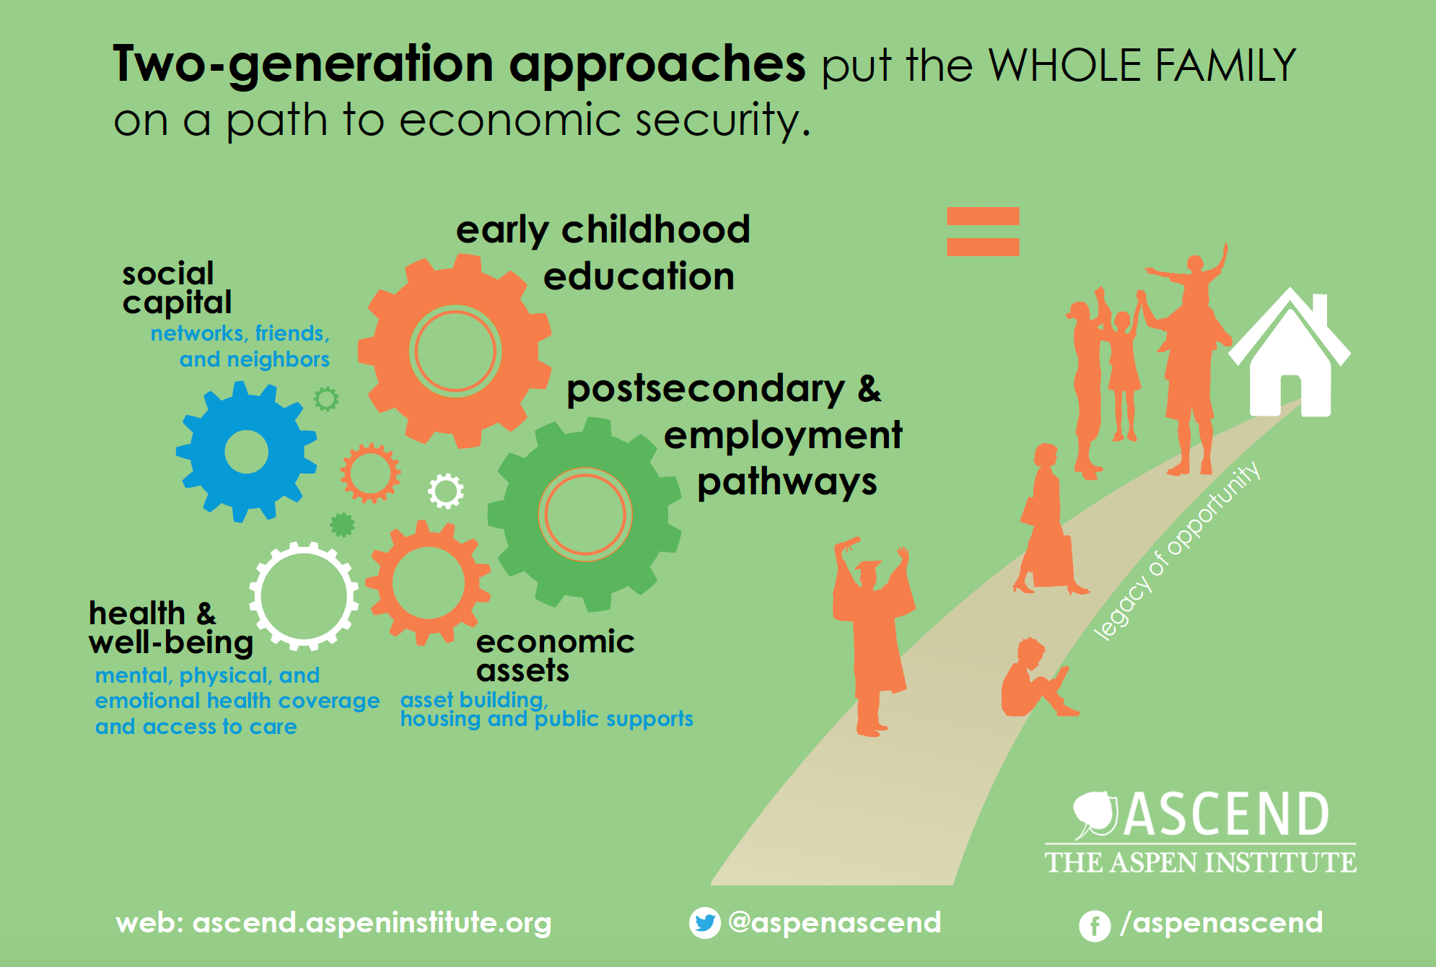
What is 2Gen?
• Helping children receive a high-quality start to their education
• Training and coaching parents to achieve better jobs and higher wages
• Building a family’s economic assets for stability
• Improving a family’s health and well-being
• Strengthening a family’s social capital and network
Notes:
While successful 2Gen work requires ALL parts of the model Ascend at the Aspen Institute puts forward, we recognize that in order to alleviate poverty, two critical components are required—those that are bigger than others in this graphic:
High quality early childhood [a point of focus]. As I mentioned, K-12 programming and some focus on growing youth of a high-quality nature is required as well. For service providers, Early Childhood Education is resourced differently than K-12 education, which is why, I suspect, it’s highlighted specifically in this context. That said, programming that serves those opportunity youth between the ages of 14-24 we spoke of last webinar, and those who are taking advantage of programs in supplement or in place of traditional school programming play important roles, as well.
Post-secondary and Employment Pathways—for adults and, in the case of kids, building toward that end.
Economic Assets—the development of those required tangible necessities and resources.
Rather than focusing on what is required to build or going into the key components of effective early childhood education programming (a topic many of you are well familiar with) or principles of adult basic education or training programs, I want instead to focus on how these work together to achieve the intended, ultimate outcome of achieving an interruption in intergenerational poverty and moving families to a position where they thrive (rather than just survive).

Slide 3
2Gen Continuum
Notes:
I want us to consider how we might transform approaches to programming, evaluation, and design in order to achieve a focus on the whole family. Today, I’ll walk us through some history (in which CAAs played a critical role—really the founding organizational environments for 2-Gen work back in the mid-60’s), a consideration of the various actors in 2-Gen work, and the intended outcomes. As we are discussing this, I’d like you to be thinking about programming within your organizations or those you support, and how you are/are not incorporating some of this already. I will open the line up for discussion when we get to a point in the second section of our webinar today.

Slide 4
Five Guiding Principles of 2Gen
Measure and account for outcomes for both children and their parents.
Engage and listen to the voices of families.
Ensure equity.
Foster innovation and evidence together.
Align systems and funding streams.
Notes:
NOTE – These five principles should be embedded into 2Gen programs, policies, and strategies:
is done through the collection of data on both adults and children members of the same family and paying attention to the interconnectedness or how one affects the other.
from principles to practice to policy — is a commitment to listen to families and ensure and structures that support parents; parents themselves fuel and create their family’s successful path toward economic security.
3. Ensure equity. The Community Action Partnerships work on 2Gen Principles to Practice in Minnesota talks about this in a slightly different way and defines the principle as “Recognizing and responding to inequity.” Two-generation strategies should evaluate and fix structural problems that create gender and/or racial and ethnic disparities in the ways that programs provide services and assistance. Many current funding streams and policies do not reflect the demographic realities of 21st century American families, where one in four U.S. children is growing up in a single-parent family, many headed by women, and where children and parents of color are disproportionately low-income. The Minnesota partnership also includes a related principle in their work—”Provide opportunity for culturally relevant and customized services.” They suggest that families have complex histories and that adaptations of programming and practice are critical in order to respect the meaning of those family identities.
4. Foster innovation and evidence together. Tap insights from prior evidence-based research and build a deliberate pipeline to ensure innovation. Policies and organizational cultures should encourage the integration of innovation into emerging evidence and evaluations of effectiveness.
5. Align and link systems and funding streams. Rarely will single funding streams fully address all the needs of children, parents, and families. Programs will need to blend and coordinate funds to deliver two-generation services. Aligning and linking systems at the state and community level — eligibility standards, performance benchmarks, and coordinated administrative structures — while simultaneously pursuing improved outcomes for both parents and children will lead to two-generation success.

Slide 5
Brief Overview: Center for Working Families
Coaching areas:
Employment coaching
Income supports coaching
Financial coaching
Coaching philosophy
Co-active coaching
Family success planning
Notes:
Child Child has a model for economic success. This would include some career exposure and benefits from the increased wages of its caretaker or parent. You may remember the stat last week that a $3,000 increase in parent salary results in a 17% salary increase for the child down the road.
Adult is motivated to climb the career ladder. Parent has improved earnings, reduction in reliance on public aid (this one is a bit slippery for some and hard to argue), defined career goals, job stability, and increased participation in training.
Family is empowered and stable. Have increased economic status and stability, financial assets, and basic needs are continuously being met.
These are linked in the resources document we will share after the webinar in a more complete format.

Slide 6
Required Roles
Service Providers
Policymakers
Researchers and Evaluators
Parents and Family Members
Partnerships and Collaborations
Notes:
Service Providers—build and deliver the programming to children and families—this is the front line. Outcomes are viewed through the lens of the organizational mission, and success is measured through outputs—number of services rendered, anecdotal evidence of progress, client satisfaction, organizational growth overall. When a service provider takes a lead role in delivering or even coordinating 2-Gen outcomes, they are challenged to design and carry out programs with equal emphasis on both generational populations. The biggest challenge is achieving the right level of both and incorporating the guiding principles across all relevant programs.
Policymakers—deliver at the population level for whole geographically defined areas. Outcomes are viewed through the lens of public good, measurable well-being of populations, and a return on investment in both short and longterm. Key challenges in this group are securing support in an environment nationally where support is more readily available for children than for adults.
Researchers/Evaluators—accumulate knowledge and evidence and inform policy, program design, and disseminate for application and development of best practices.
Families—involvement in programming is a commitment to making life better for families. Biggest challenge for this group is being heard—having a voice that is of equal value to other stakeholders in the design of service and policy.
Partnerships and Collaborations—very likely the case that no one organization can meet all the needs in the 2-Gen model. Collaborations and partnerships propel the work in a meaningful way for both the full ecosystem and at the single organizational level. Critically important to define common goals.

Slide 7
What is your role?
Service Provider
Policymaker
Researcher and/or Evaluator
Client
Partner and/or Collaborator
Notes:
I would like us to take some time to think about where you all fall in this spectrum of roles. I know that you may be coming unprepared to discuss this question in particular this morning, so it’s okay if we have a dialogue. But, even if your position isn’t crystal clear, I would like for us to begin to think about this in the context of what you have done, what you currently offer, and what you have been considering with your work as you move through this thought process.
I’ll start by saying that UWCI has served in many, if not all, of these roles in the last decade or more (with the possible exception of clients [although, I know many staff in this line of work do take advantage of services, when circumstances require it]). We were awarded with a federal Social Innovation Fund grant of 7 million dollars to kick-start more deliberate 2-Gen work in areas where there is growing crime and poverty around Marion County. Since that began, we have worked hard to place ourselves in the position as partner and collaborator by offering ongoing capacity building to those participating in the work—through peer networking, consultation and technical assistance, and research and evaluation assistance, in addition to funding. As many of you know, likely, from your roles coordinating multiple community based programs, because this was a federal grant, there were lots of shifts and federal administration changes in 2017, and there have been a lot of adjustments with our partners based on the compliance demands of the funding. We are learning a lot, and I think we are learning that in order to move the needle, this has to be a long term effort with community-wide implications.
So when we revised our strategic framework in 2018, we began to revision ourselves with a focus more in the policy and research portions of the work—funding activity, not providing direct service, advocating for vulnerable populations not just the organizations that serve them, arranging partnerships, and convening research and evaluation systems and analysis both in the short term and the long term.
I would like for us to take some time now to talk this through.
Indiana Community Action Agencies operate Head Start, basic needs supportive services like Energy Assistance Programs, Weatherization, and those stabilizing programs like Individual Development Accounts, Homeownership Counseling, Owner Occupied Rehabilitation, Housing Development, Foster Grandparents, Child Care, and more.
Can you share an example of where your organization is serving in one or more of these areas? Are you connecting parent/child focused outcomes already within your program design and evaluation? Or are they operating separately? Where are you on the continuum of child to parent focused?

Slide 8
Workforce Development and Economic Assets Outcomes
CHILD-has a model for economic success.
ADULT-is motivated to climb career ladder.
FAMILY-is empowered and stable.
Notes:
Child Child has a model for economic success. This would include some career exposure and benefits from the increased wages of its caretaker or parent. You may remember the stat last week that a $3,000 increase in parent salary results in a 17% salary increase for the child down the road.
Adult is motivated to climb the career ladder. Parent has improved earnings, reduction in reliance on public aid (this one is a bit slippery for some and hard to argue), defined career goals, job stability, and increased participation in training.
Family is empowered and stable. Have increased economic status and stability, financial assets, and basic needs are continuously being met.
These are linked in the resources document we will share after the webinar in a more complete format.

Slide 9
Barriers to Finding/Maintaining employment
Toxic stress
Lack of social capital
Lack of supplemental resources
Access to childcare
Notes:
Child Child has a model for economic success. This would include some career exposure and benefits from the increased wages of its caretaker or parent. You may remember the stat last week that a $3,000 increase in parent salary results in a 17% salary increase for the child down the road.
Adult is motivated to climb the career ladder. Parent has improved earnings, reduction in reliance on public aid (this one is a bit slippery for some and hard to argue), defined career goals, job stability, and increased participation in training.
Family is empowered and stable. Have increased economic status and stability, financial assets, and basic needs are continuously being met.
These are linked in the resources document we will share after the webinar in a more complete format.

Slide 10
Questions

